Slide 1
HOSA Meeting
9/13/23

Slide 2
Remind
HOSA Lower Chapter:
@hosalow24
HOSA Upper Chapter:
@hosaupp24

Slide 3
Executive Board
Upper Chapter
Lower Chapter
Sama Shokr | President
Olivia Nguyen | President-Elect
Ena Ibrahimovic | Vice President
Esther Brietling | Corresponding Secretary
Rae Daniels | Recording Secretary
Jacey Ghaly | Recorder/Parliamentarian
Ryla Alabat | Treasurer
Briana Pate | Historian
Jai Popuri | President
amna ibrahimovic | President-elect
Samantha Bates | Vice President
Ema Alcani | Secretary
Skyler Rideout | Parliamentarian
Mathew Habib | Treasurer

Slide 4
Committee Leaders
Trevor Stintson | Conferences/Competitions
Christopher Hastings | HOSA Week
Rachael Uvieghara | Glam Run
Marolina Binyamen, Valerie Sanchez | Celebrations
Yassin Elsammek | Fundraising
Paola Prada | Philanthropy

Slide 5
Membership Points and Hours
Upper Chapter 11th & 12th :
15 points
Lower Chapter 9th &10th :
10 points
1 point for every meeting
Fees: $45 on revtrak
Due: September 22nd
Competing at States = enough membership points
We offer plenty of medical hours for various events
Seniors make sure you have 15 points by the end of the year for cords

Slide 6
T-Shirts
They are Live!!
Amount: $12
Due: September 22nd

Slide 7
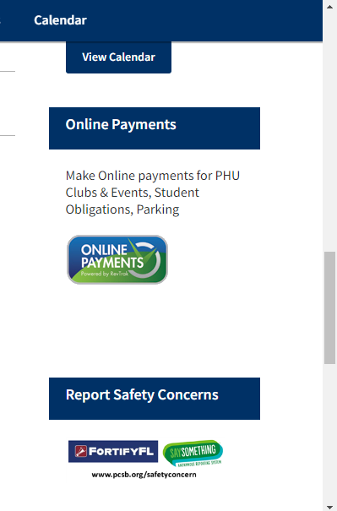
Membership

Slide 8
Lower Chapter Positions/Letter of Intent
Due: September 22nd
Email your letters to your medical teacher
Election date: October 2nd
Board Positions Available:
Vice President
President-elect: only 9th grade
Secretary

Slide 9
Future General Meeting Dates
October 11th
November 8th
December 13th
January 10th
February 14th
March 20th
April 10th

Slide 10
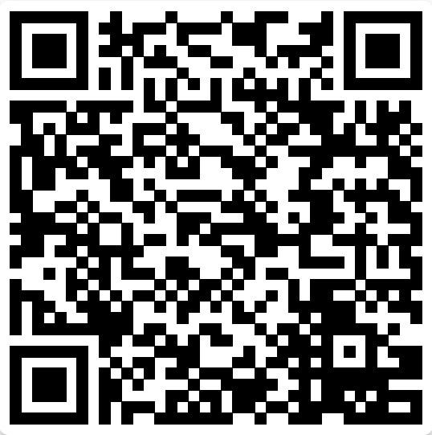
T-Shirts
Thank You!!

